Slide 1

Chapter 15
Transmission
Control
Protocol
(TCP)
TCP/IP Protocol Suite
Copyright © The McGraw-Hill Companies, Inc. Permission required for reproduction or display.

Slide 2

OBJECTIVES:
To introduce TCP as a protocol that provides reliable stream delivery service.
To define TCP features and compare them with UDP features.
To define the format of a TCP segment and its fields.
To show how TCP provides a connection-oriented service, and show the segments exchanged during connection establishment and connection termination phases.
To discuss the state transition diagram for TCP and discuss some scenarios.
To introduce windows in TCP that are used for flow and error control.
TCP/IP Protocol Suite

Slide 3

OBJECTIVES (continued):
To discuss how TCP implements flow control in which the receive window controls the size of the send window.
To discuss error control and FSMs used by TCP during the data transmission phase.
To discuss how TCP controls the congestion in the network using different strategies.
To list and explain the purpose of each timer in TCP.
To discuss options in TCP and show how TCP can provide selective acknowledgment using the SACK option.
To give a layout and a simplified pseudocode for the TCP package.
TCP/IP Protocol Suite

Slide 4
Chapter
Outline
15.1 TCP Services
15.2 TCP Features
15.3 Segment
15.4 A TCP Connection
15.5 State Transition Diagram
15.6 Windows in TCP
15.7 Flow Control
15.8 Error Control
15.9 Congestion Control
15.10 TCP Timers
15.11 Options
15.12 TCP Package
TCP/IP Protocol Suite

Slide 5
15-5 STATE TRANSITION DIAGRAM
To keep track of all the different events happening during connection establishment, connection termination, and data transfer, TCP is specified as the finite state machine shown in Figure 15.13.
TCP/IP Protocol Suite

Slide 6
Topics Discussed in the Section
Scenarios
TCP/IP Protocol Suite

Slide 7
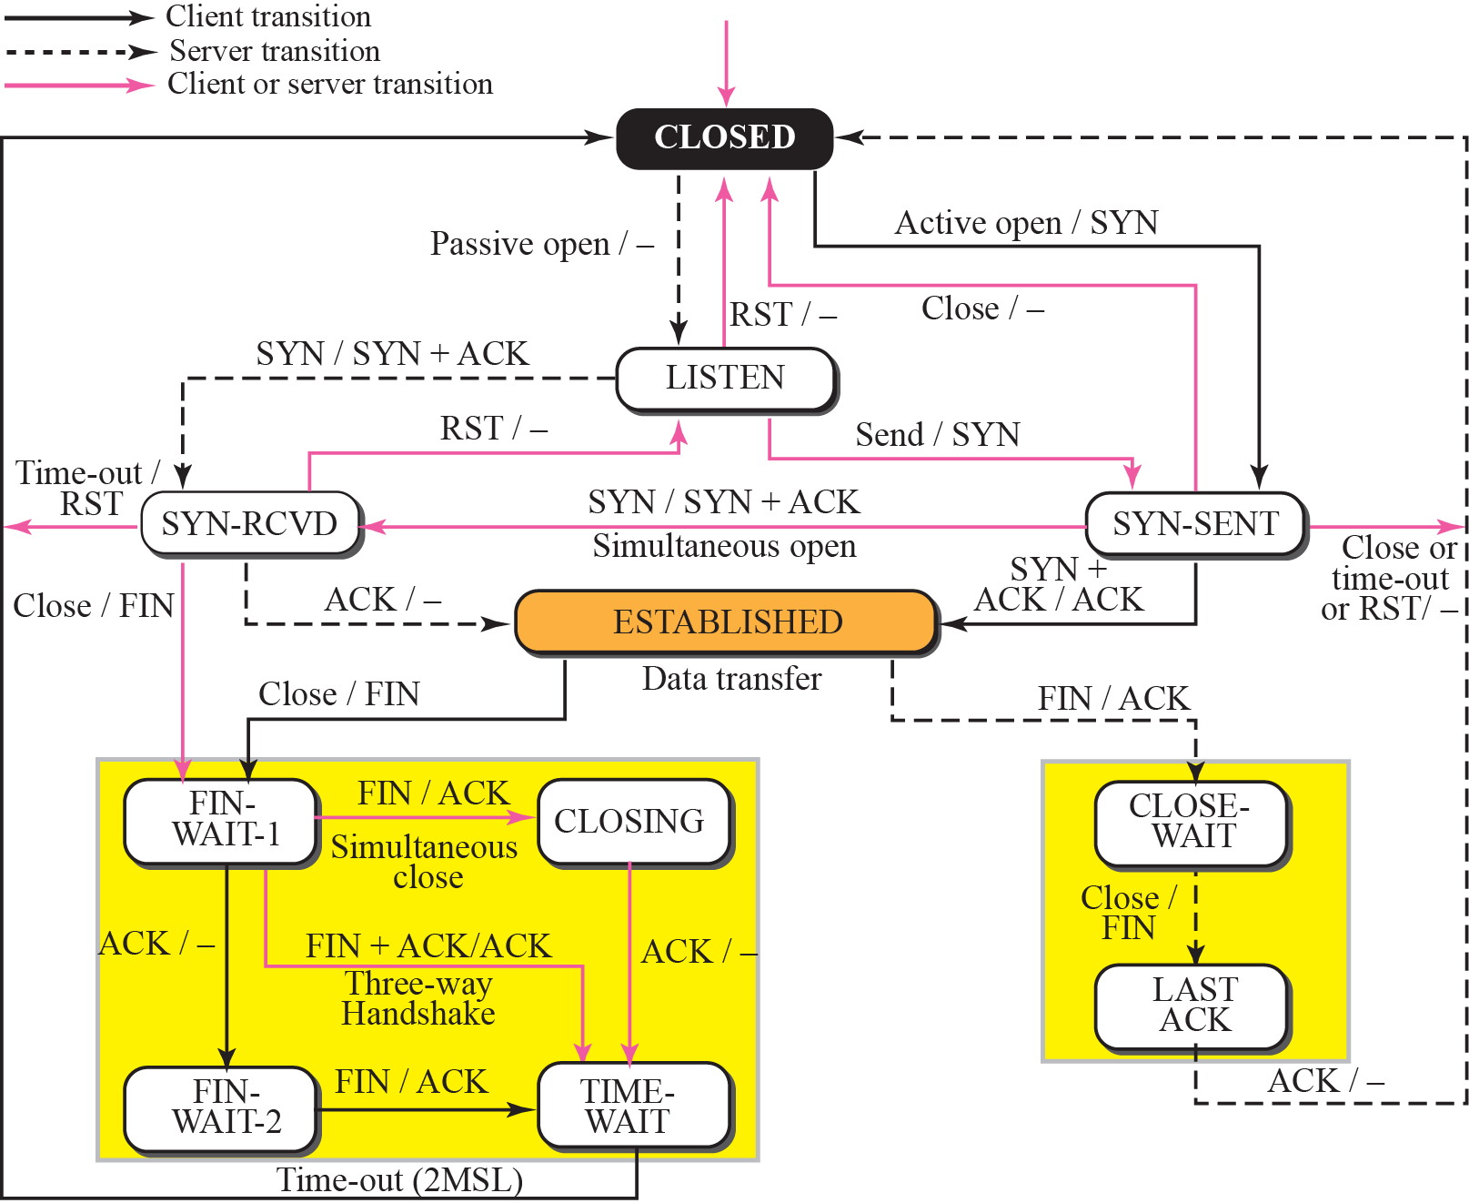
Figure 15.13 State transition diagram
TCP/IP Protocol Suite

Slide 8

Note
The state marked as ESTBLISHED
in the FSM is in fact two different
sets of states that the client
and server undergo to transfer data.
TCP/IP Protocol Suite

Slide 9
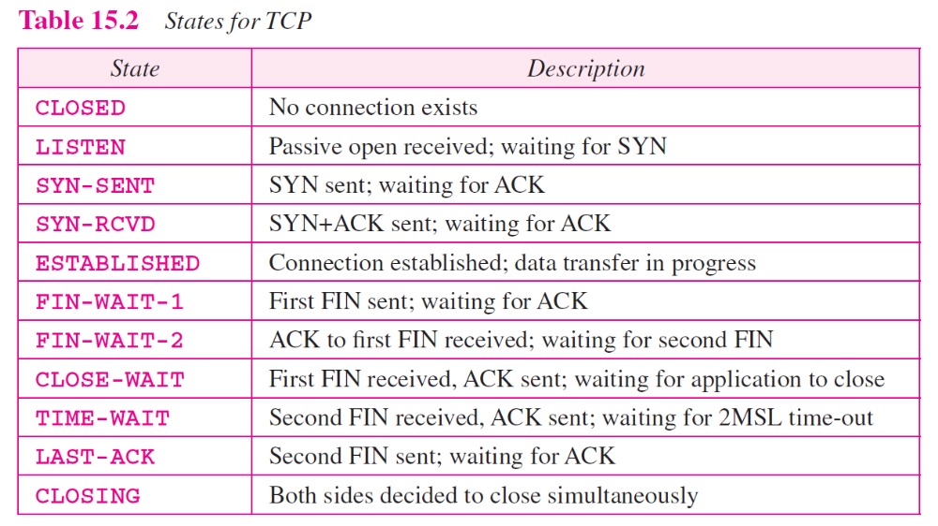
TCP/IP Protocol Suite

Slide 10
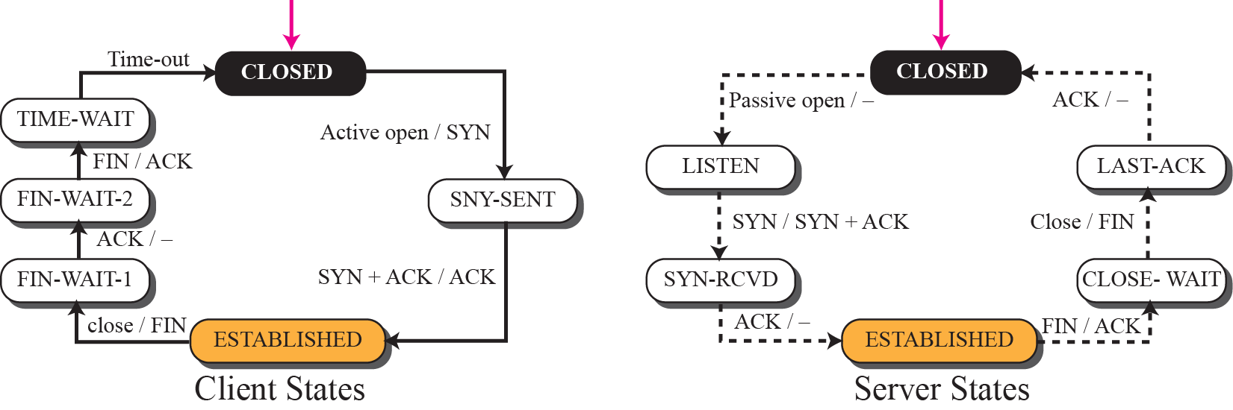
Figure 15.14 Transition diagram for connection and half-close termination
TCP/IP Protocol Suite

Slide 11
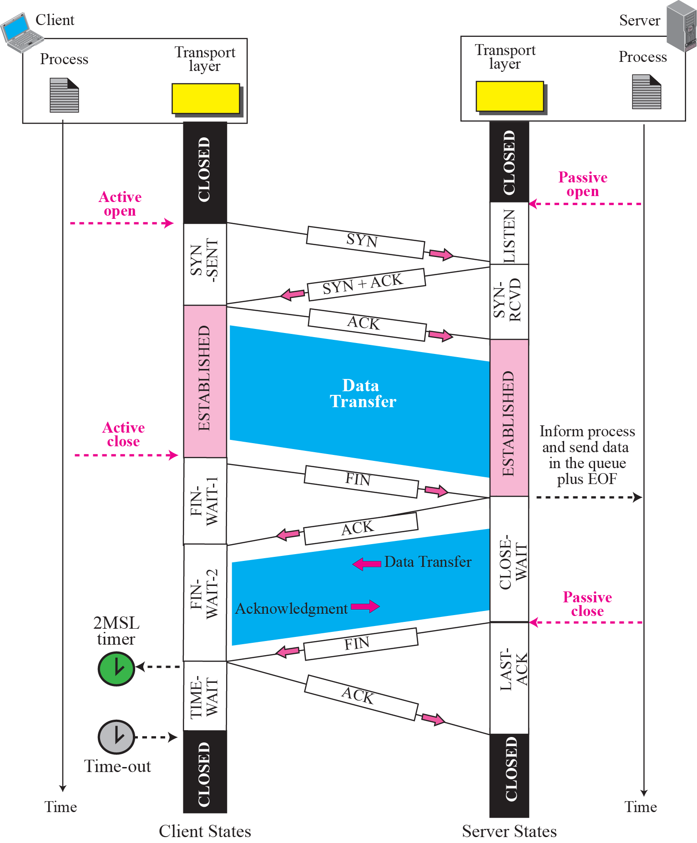
Figure 15.15 Time-line diagram for Figure 15.14
1. Enough time for an ACK to be lost and a new FIN to arrive. If during the TIME-WAIT state, a new FIN arrives, the client sends a new ACK and restarts the 2MSL timer
To prevent a duplicate segment from one connection appearing in the next one, TCP requires that incarnation cannot take place unless 2MSL amount of time has elapsed.
Another solution: the ISN of the incarnation is greater than the last seq. # used in the previous connection.
TCP/IP Protocol Suite

Slide 12
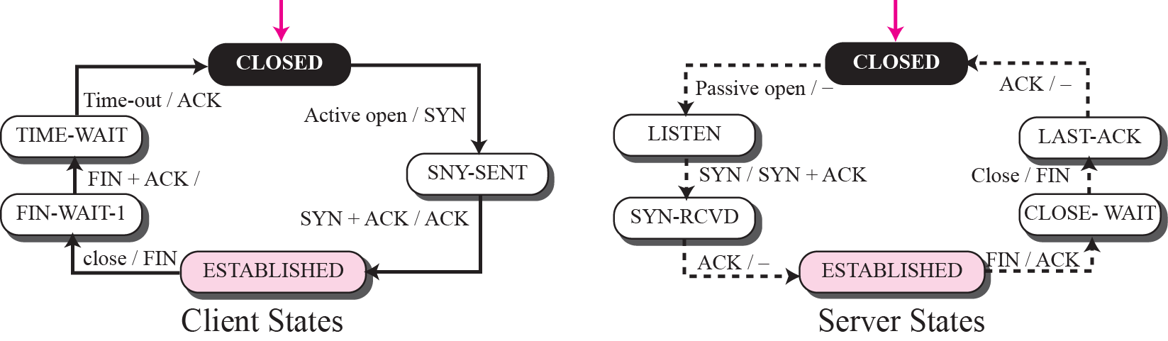
Figure 15.16 Transition diagram for a common scenario
TCP/IP Protocol Suite

Slide 13
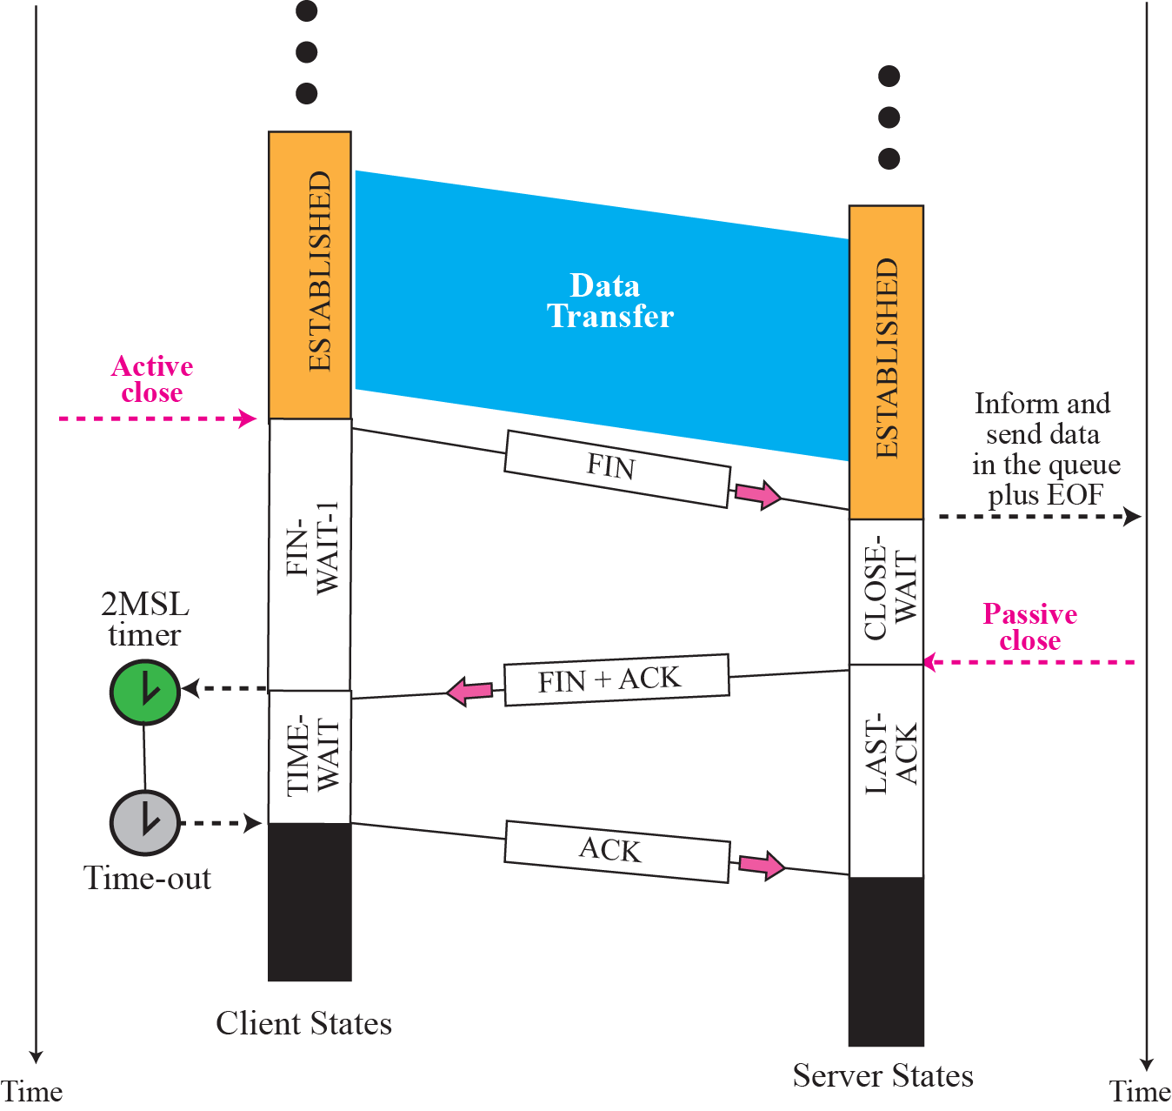
Figure 15.17 Time line for a common scenario
TCP/IP Protocol Suite

Slide 14
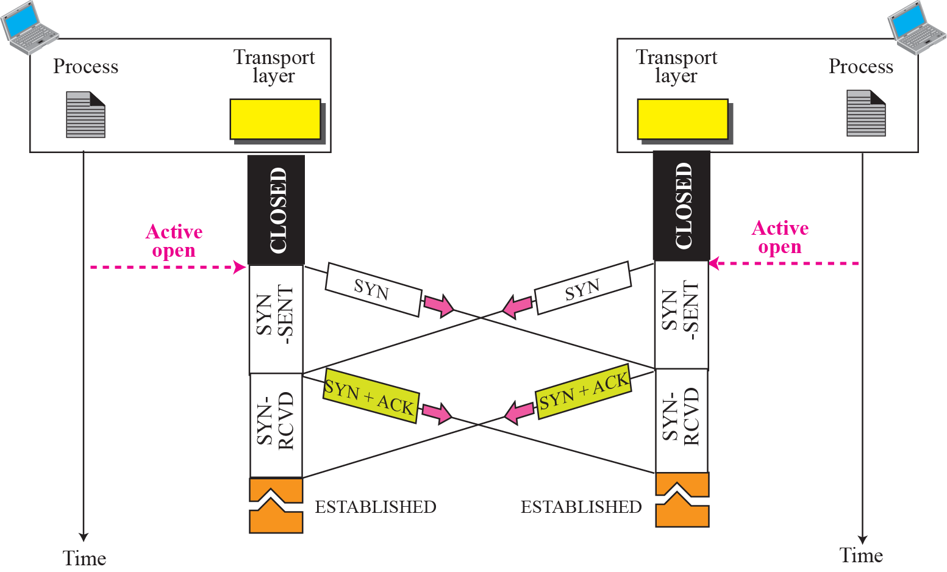
Figure 15.18 Simultaneous open
TCP/IP Protocol Suite

Slide 15
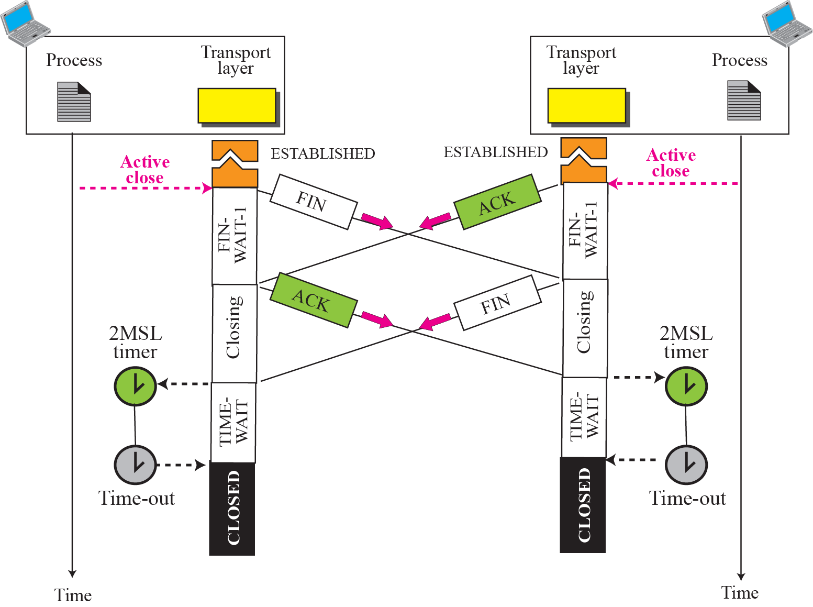
Figure 15.19 Simultaneous close
ex
TCP/IP Protocol Suite

Slide 16
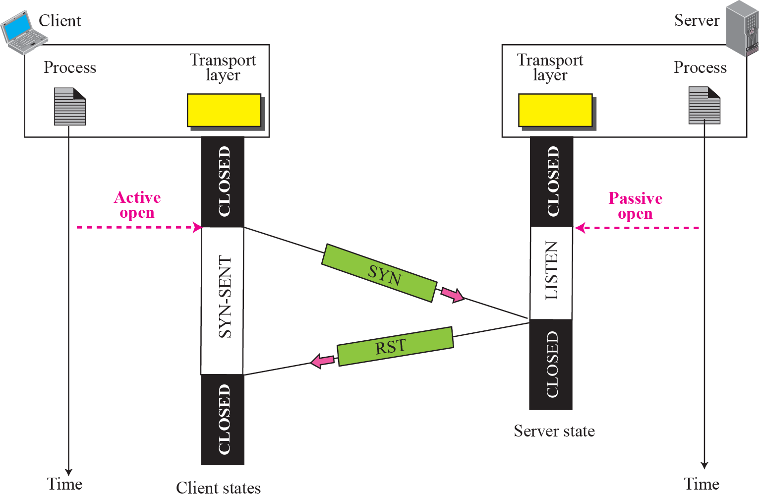
Figure 15.20 Denying a connection
TCP/IP Protocol Suite

Slide 17
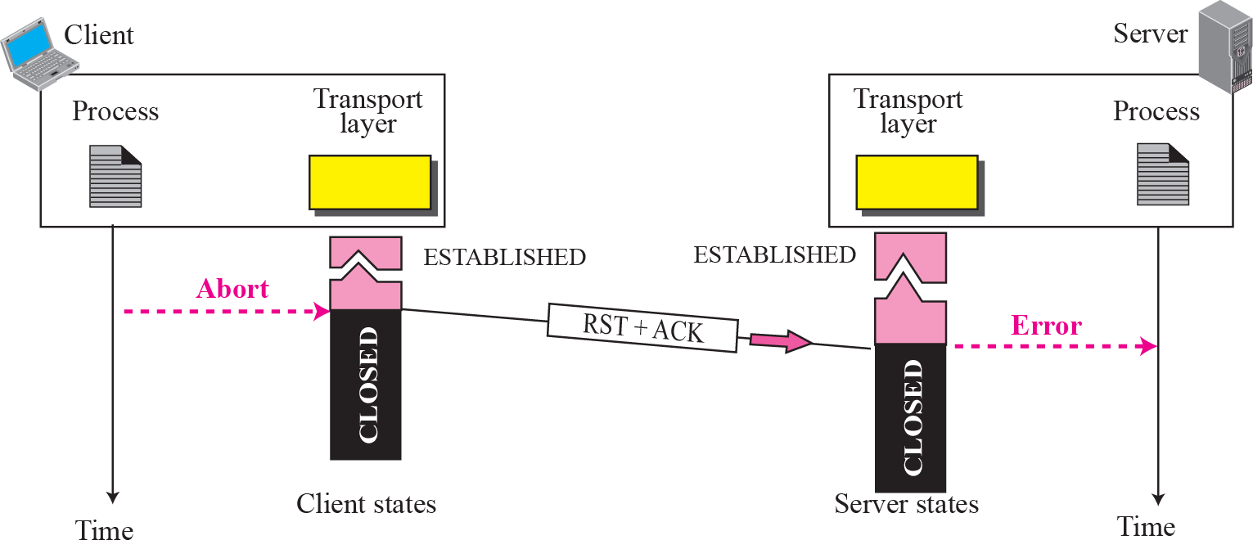
Figure 15.21 Aborting a connection
TCP/IP Protocol Suite

Slide 18
End of 15.5 State Transition Diagram.
TCP/IP Protocol Suite

